Slide 1
On the Reproducibility of MPI Reduction Operations
Pavan Balaji
Computer Scientist
Group Lead, Programming Models and Runtime Systems
Dries Kimpe
Assistant Computer Scientist
Mathematics and Computer Science Division
Argonne National Laboratory

Slide 2
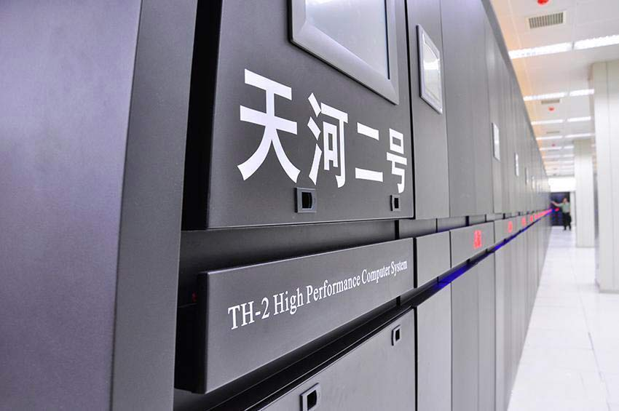
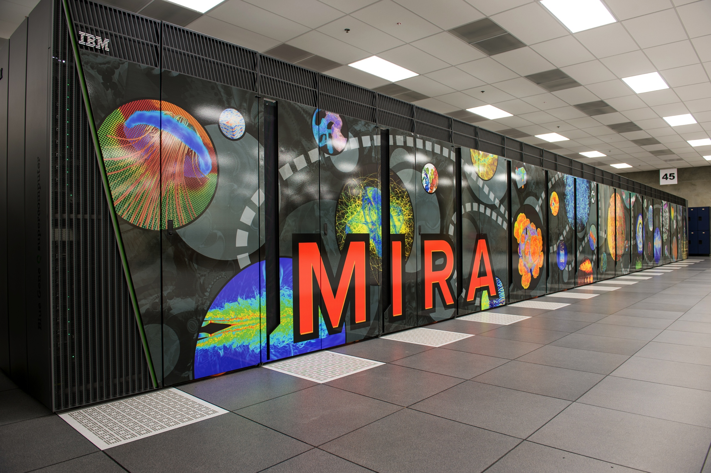
Scientific Simulations and Parallel Computing
Increasing importance of parallel computing for scientific simulations
Increasingly large system sizes, in the 10s of petaflops today
Expected to increase to an exaflop level performance by the end of this decade
Used in almost all aspects of scientific computing
Alternative energy (biofuels, solar cells), improvements to non-fossil-fuels (nuclear reactors), sophisticated batteries, efficient automobiles (flights, cars)
Tianhe-2 (China), 32 Petaflops; 3.12 million cores
Mira (Argonne, USA), 10 Petaflops; 0.76 million cores

Slide 3
Reproducibility in Scientific Simulations
What is reproducibility?
When you run the same simulation with the same input, you get the same result
Different levels of reproducibility exist, including bit-wise reproducibilty
Cost of bit-wise reproducibility is high, especially for large-scale machines
Cannot have any nondeterminism in the execution; all steps of the execution have the follow the same path every time
Benefits are mainly with correctness checks
Very simple correctness properties: you either get the same answer (correct) or you don’t (incorrect)
Several applications tend to require bit-wise reproducibility, sometimes just for contractual reasons
Examples in nuclear reactors, drug designs

Slide 4
MPI Reduction Operations
MPI (Message Passing Interface) is the de facto standard for parallel programming on supercomputers
MPI Reduction operations are a heavily used subset of the MPI standard
MPI_REDUCE, MPI_ALLREDUCE, MPI_SCAN, MPI_EXSCAN, etc.
Used to compute on data contributed by a group of processes, the result of which is deposited on one or all processes
Every process contributes one element to the reduction (loosely speaking)
MPI-3.0 does not guarantee a deterministic behavior, but strongly recommends it
Impact: several optimizations need to be disabled
when MPI runs in “deterministic mode”
Most MPI implementations provide such a
“deterministic mode” either by default or through
an environment or configuration setting

Slide 5
Reproducibility Issues in MPI Reduction Operations
Two primary sources of nondeterminism
Nondeterministic computational flow
E.g., one way of doing reduction is to locally compute in whatever order the incoming messages arrive
Not a problem in most MPI implementations
Order of computation: A + (B + C) != (A + B) + C
Example of unordered computation: Topology-aware reduction
The idea of topology-aware reduction is to take advantage of the physical hierarchy of the system for reduction
Local reduction on the node; only the result is forwarded to other nodes: improves number of network messages and hence performance
Obviously, the order of operations depends on the hardware topology

Slide 6
Reproducibility Issues with Order of Computation
Order of computation: A + (B + C) != (A + B) + C
Floating point arithmetic loses information when a large value is added to a small value
Consider: S = A[1] + A[2] + A[3] + … + A[1billion]
A[1] = A[2] = A[3] = … = A[1billion – 1] = 1e-5
A[1biillion] = 1e5
Option 1:
Add A[1], A[2], …, A[1billion – 1] first, we get: 1e4
Add this to A[1billion], we get, S = 1e5 + 1e4 = 1.1e5
Option 2:
Add A[1billion] + A[1], we get: 1e5 + 1e-5 = 1e5 (rounding)
Now, add (A[1billion] + A[1]) + A[2]: 1e5 + 1e-5 = 1e5 (rounding)

Slide 7
Contributions of this paper
The focus of this paper is to understand the performance and correctness implications of nondeterministic MPI reduction operations
How much performance improvement can be get through nondeterministic reductions?
How much inconsistency do we generate in the result due to this nondeterminism?
In this paper, we use MPI_SUM as a case study, but the conclusions apply to other operations as well

Slide 8
Topology-aware Reductions
Primary goal is performance optimization at the cost of (some) loss of determinism/reproducibility
Example of topology-aware reduction is with multicore nodes
Several implementations of MPI (e.g., MPICH, MVAPICH, and Intel MPI), detect the physical topology of the node and optimize reduction operations for multicore architectures
0
1
4
5
0
1
2
3
2
3
6
7
4
5
6
7
8
9
12
13
8
9
10
11
10
11
14
15
12
13
14
15

Slide 9
Consequences of Nondeterminism
Accuracy
Reproducibility != Accuracy
The MPI standard does not require reduction operations to be in a particular order
Even if the result is deterministic, the order of the operations might not lead to the best precision
Precision cost of nondeterminism
Order of operations can cause an absolute error of:
abs(E) = g(log(N)) x Σ|X_{i}|
g(N) = (N x u) / (1 – (N x u))
u: unit of round off (1e-16 for double precision); N: number of elements
Relative error compared to output:
rel(E) = log(N) x u / (1 – (log(N) x u))
Nicholas J. Higham. “Accuracy and Stability of Numerical Algorithms”. SIAM, 1996

Slide 10
Other Sources of Nondeterminism
Compilers
Languages like C/C++ and Fortran give a lot of freedom to compilers to reorder instructions as needed by ignoring parallelism
Explicit assembler-level instructions are needed to ensure consistency
Hardware instructions
Most hardware allows multiple instructions to be in-flight and execute out-of-order between processes
If an architecture supports fused-multiply-add (FMA) instructions, the compiler might try to take advantage of it; however, in some conditions such an instruction might throw an error or exception forcing execution to a different computation path
Other programming models
OpenMP reductions have the same problem: threads might contribute their data out-of-order
MPI implementations might use hardware features in some hardware configurations and not use them in others

Slide 11
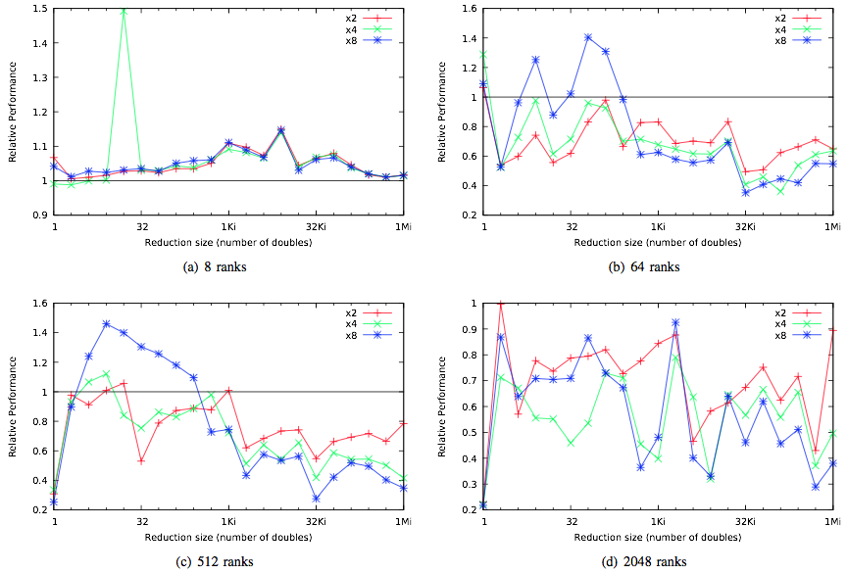
Impact of Topology on Performance (MPI_REDUCE)

Slide 12
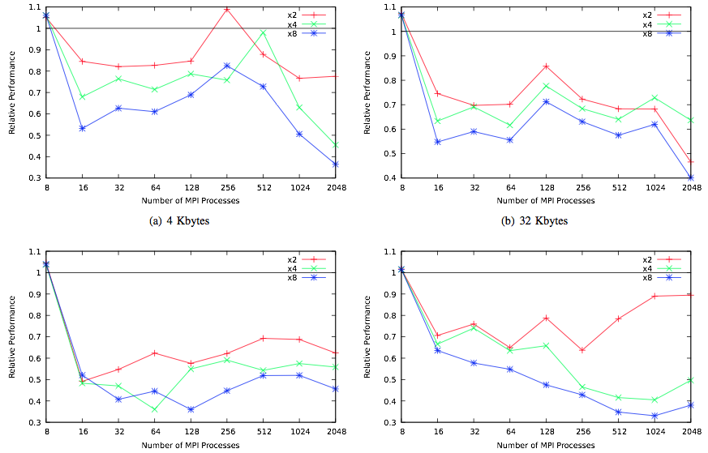
Impact of System Size on Performance (MPI_REDUCE)

Slide 13
Impact of Topology on Reproducibility
Remember that:
rel(E) = log(N) x u / (1 – (log(N) x u))
For most modern systems, N is quite small:
Tianhe-2: N = 3.12e6; log(N) = 21.57
Sequoia: N = 1.5e6; log(N) = 20.52
At exascale, N is expected to be around 1e9; log(N) = 29.9
For double precision arithmetic, u = 1e-16
At these values, rel(E) is around 1e-14 to 1e-15 or 0.000000000001%
Unless the application does several billions of reduction operations, and these errors accumulate, it should not make a difference in practice

Slide 14
Concluding Remarks
Nondeterminism in MPI reduction operation has traditionally been discouraged because of the potential of non-reproducible results
This paper demonstrates that:
Deterministic computational guarantees in MPI reduction are very expensive with respect to performance: ~3X performance difference
Do not make significant impact on the accuracy even at Exascale
Recommendations:
We should completely discard the pretense of deterministic execution
This is not practical and is already very hard to achieve in practice; it will only get harder
We should embrace nondeterministic executions and invest in algorithmically bounding such inaccuracies

Slide 15










Funding Acknowledgments
Funding Grant Providers
Infrastructure Providers

Slide 16
Programming Models and Runtime Systems Group
Group Lead
Pavan Balaji (computer scientist)
Current Staff Members
Antonio Pena (postdoc)
Wesley Bland (postdoc)
Huiwei Lu (postdoc)
Junchao Zhang (postdoc)
Ken Raffenetti (developer)
Other Affiliates
Xiaomin Zhu (visiting researcher), to start in 2014
Yuqing Xiong (visiting researcher)
Past Staff Members
Ralf Gunter (research associate)
James S. Dinan (postdoc)
David J. Goodell (developer)
Darius T. Buntinas (developer)
Current and Past Students
Rengbo Pang (Ph.D.), to start in 2014
Marius Horga (M.S.)
Xiuxia Zhang (Ph.D.)
Brian Skjerven (Ph.D.)
Amer Halim (Ph.D.)
Chaoran Yang (Ph.D.)
Min Si (Ph.D.)
Xin Zhao (Ph.D.)
Alex Brooks (Ph.D.)
Huiwei Lu (Ph.D.)
Yan Li (Ph.D.)
David Ozog (Ph.D.)
Palden Lama (Ph.D.)
Ziaul Haque Olive (Ph.D.)
Md. Humayun Arafat (Ph.D.)
Qingpeng Niu (Ph.D.)
Li Rao (M.S.)
Lukasz Wesolowski (Ph.D.)
Feng Ji (Ph.D.)
John Jenkins (Ph.D.)
Ashwin Aji (Ph.D.)
Shucai Xiao (Ph.D.)
Sreeram Potluri (Ph.D.)
Piotr Fidkowski (Ph.D.)
James S. Dinan (Ph.D.)
Gopalakrishnan Santhanaraman (Ph.D.)
Ping Lai (Ph.D.)
Rajesh Sudarsan (Ph.D.)
Thomas Scogland (Ph.D.)
Ganesh Narayanaswamy (M.S.)
Advisory Board
Rajeev Thakur (deputy division director)
Marc Snir (division director)
Rusty Lusk (retired, STA)

Slide 17
We are looking for people!
Multiple openings for various research positions at Argonne (U.S. Department of Energy National Laboratory)
M.S. level: Graduate students and Predoctoral researchers
Ph.D. level: Graduate students and Postdoctoral researchers
Senior positions: Software developer and Assistant computer scientist
U.S. citizenship not required; work visas are sponsored
Work on the largest supercomputers in the world
Focus areas are in scientific computing and cloud computing
Various projects on Runtime systems
MPI and other communication systems
Threading models and Operating Systems
Accelerator models (GPUs, Intel Xeon Phi, heterogeneous memory models)
Contact: balaji@mcs.anl.gov or http://www.mcs.anl.gov/~balaji

Slide 18
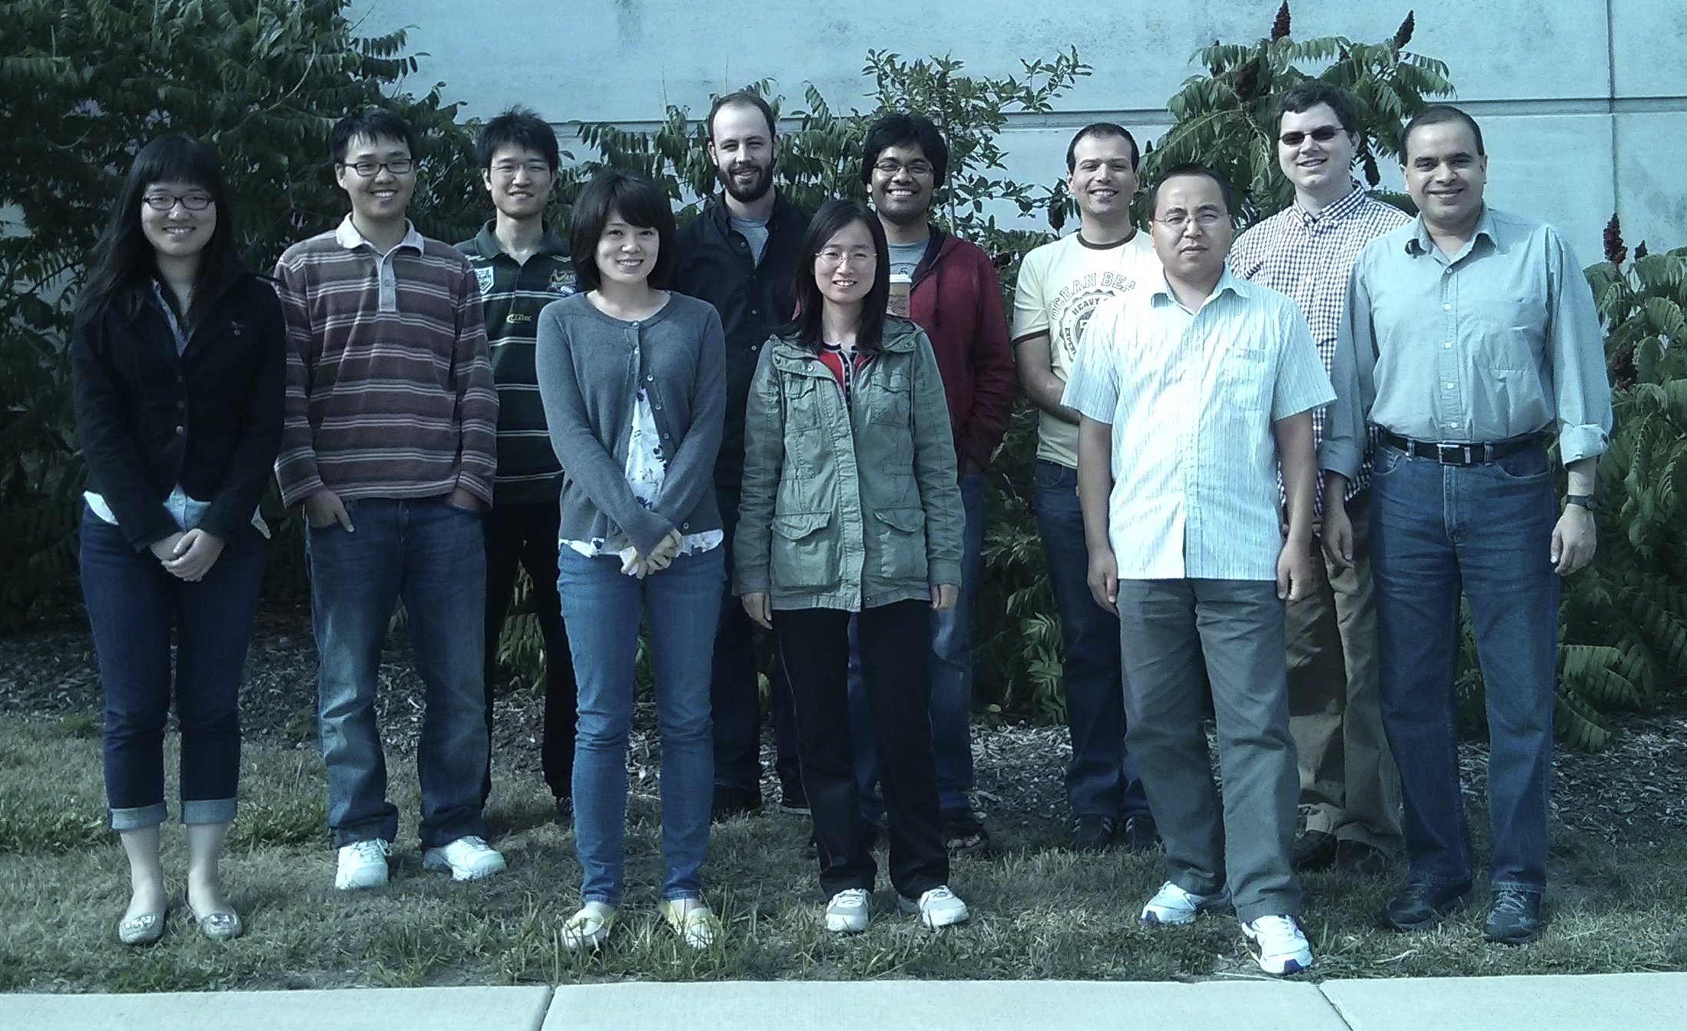
Web: http://www.mcs.anl.gov/~balaji Email: balaji@mcs.anl.gov
Group website: http://collab.mcs.anl.gov/display/PMRS

